Slide 1
Adult income dataset visualizations and predictive models
J. Tulani Aytch

Slide 2
Business problem:
Visualization of various features from a dataset on income and testing of predictive models on the given data to help make predictions on the average income of an adult, specifically whether they would be earning more or less than 50k.

Slide 3
Data:
Adult income dataset from Kaggle.
14 features and 48842+ instances.
Features include the individual’s education level, age, gender, occupation, and etc.
Data link:
https://www.kaggle.com/datasets/wenruliu/adult-income-dataset

Slide 4
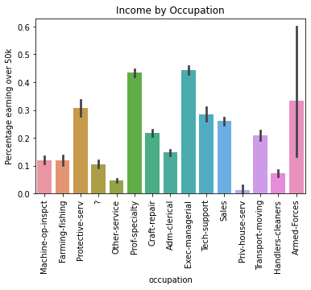
Visual 1: Income by Occupation
Income based on whether or not person earned 50K or less, with 1 being > 50k and 0 being < 50k.
The job with the highest amount of people with sub 50k incomes was priv-house-serv.
The jobs with the highest amount of people with 50k+ incomes were, Exec-managerial, and Prof-Specialty, with around 44-45%.
High deviation with armed forces.

Slide 5
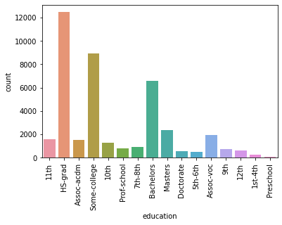
Visual 2: Count of Educational background
Vast majority of people did not finish college.
Far more people in the dataset earned less than 50k.
Potentially valuable information to be found here.

Slide 6
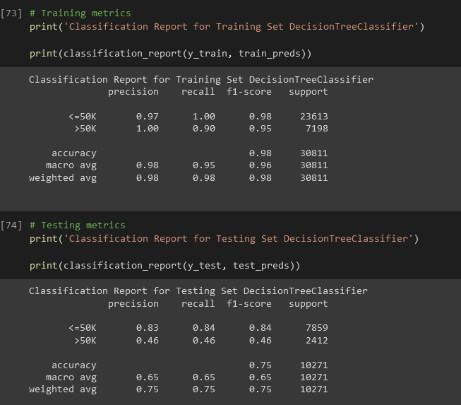
Predictive Model chosen for Dataset
Model is a DecisionTreeClassifier.
Performed well on <50k instances.
No model performed well on test data for 50k>, but this model performed the best.
Overall balanced metrics.

Slide 7
Final recommendations
For the Dataset:
Consider finding subject matter expert for:
Correlation between not finishing college and lower income
Finding out what the “other-service” column entails.
What leads to certain jobs earning more/less?
Data is from 1994 (consider inflation).
For the Model:
Far less data for over 50k than under
Dataset includes race, gender, and native country.
Needs tuning before deploying.

